Slide 1
Data Science Process
Unit 02 Lecture 02
Dr Muhammad Ismail Mangrio

Slide 2
Contents
Understanding the flow of a data science process
Discussing the steps in a data science process

Slide 3
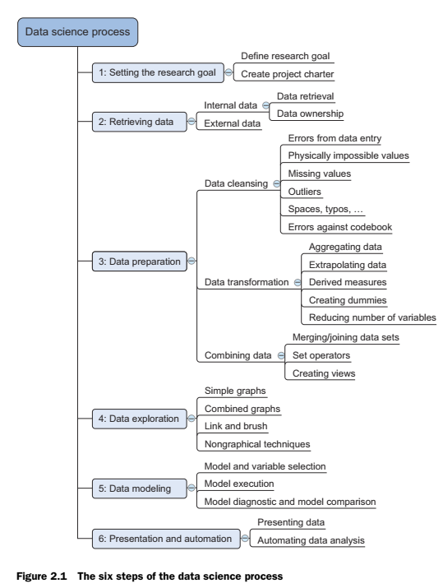
Overview of the data science process
A structured approach to data science helps you to maximize your chances of success in a data science project at the lowest cost.
It also makes it possible to take up a project as a team, with each team member focusing on what they do best.
The typical data science process consists of six steps :

Slide 4
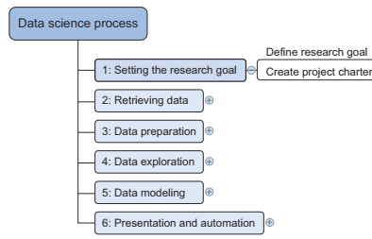
Step 1: Defining research goals and creating a project charter
Defining Research goals:
  A project starts by understanding the what, the why, and the how of your project
    What does the company expect you to do?
    And why does management place such a value on your research?
    Is it part of a bigger strategic picture or a “lone wolf” project originating from an opportunity someone detected?
  So that, everybody knows what to do and can agree on the best course of action.
Create project charter/contract:
  The outcome should be a clear research goal, a good understanding of the context, well-defined deliverables, and a plan of action with a timetable. This information is then best placed in a project charter.
  The length and formality can, of course, differ between projects and companies.
  In this early phase of the project, people skills and business acumen are more important than great technical prowess, which is why this part will often be guided by more senior personnel.

Slide 5
Step 1: Defining research goals and creating a project charter
A project charter requires teamwork, and your input covers at least the following:
  A clear research goal
  The project mission and context
  How you’re going to perform your analysis
  What resources do you expect to use
  Proof that it’s an achievable project, or proof of concepts
  Deliverables and a measure of success
  A timeline
Your client can use this information to estimate the project cost.

Slide 6
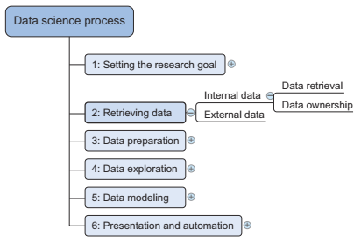
Step 2: Retrieving data
Start with data stored within the company
  Assess the relevance and quality of the data that’s readily available within your company. Most companies have a program for maintaining key data, so much of the cleaning work may already be done.
  This data can be stored in official data repositories such as databases, data marts, data warehouses, and data lakes maintained by a team of IT professionals.
The primary goal of a database is data storage, while a data warehouse is designed for reading and analyzing that data
Challenges:
  Finding data even within your own company can sometimes be a challenge. As companies grow, their data becomes scattered across many places. Knowledge of the data may be dispersed as people change positions and leave the company.
  Documentation and metadata aren’t always the top priority of a delivery manager, so you may need to develop some skills to find all the lost bits.
  Getting access to data is another difficult task.
  Organizations understand the value and sensitivity of data and often have policies in place so everyone has access to what they need and nothing more.

Slide 7
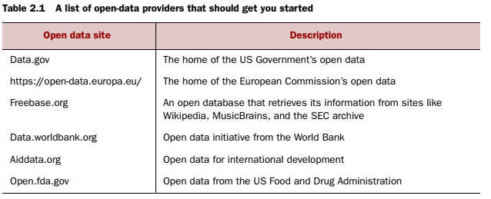
Step 2: Retrieving data
Don’t be afraid to shop around
If data isn’t available inside your organization, look outside your organization’s walls. Many companies specialize in collecting valuable information. For instance, Nielsen and GFK are well known for this in the retail industry.
Other companies provide data so that you, in turn, can enrich their services and ecosystem. Such is the case with X (Twitter), LinkedIn, and Facebook.
Although data is considered an asset more valuable than oil by certain companies, more and more governments and organizations share their data for free with the world. This data can be of excellent quality; it depends on the institution that creates and manages it.
The information they share covers a broad range of topics, such as the number of accidents or the amount of drug abuse in a certain region and its demographics.
This data is helpful when you want to enrich proprietary data, but also convenient when training your data science skills at home.

Slide 8
Step 2: Retrieving data
Do data quality checks now to prevent problems later
  Expect to spend a good portion of your project time doing data correction and cleansing, sometimes up to 80%.
  Most of the errors you’ll encounter during the data gathering phase are easy to spot, but being too careless will make you spend many hours solving data issues that could have been prevented during data import.
  You’ll investigate the data during the import, data preparation, and exploratory phases.
    During data retrieval, you check to see if the data is equal to the data in the source document and look to see if you have the right data types.
    Once you find the problems with the data, you can improve the quality of the data, known as “data preparation”

Slide 9
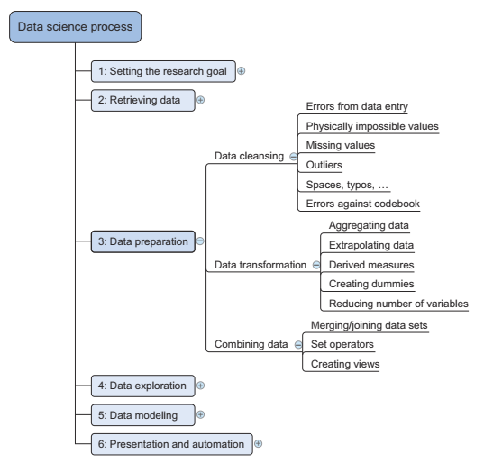
Step 3: Data Preparation: Data cleansing
The data received from the data retrieval phase is likely to be “a diamond in the rough”.
Sanitize and prepare it for use in the modeling and reporting phase.
  It’s tremendously important because your models will perform better and you’ll lose less time trying to fix strange output.
  Otherwise, it can be “garbage in equals garbage out”.

Slide 10
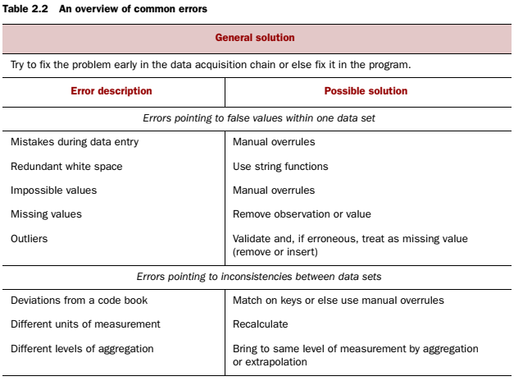
Step 3: Data Preparation: Data cleansing
  It focuses on removing errors in your data so your data becomes a true and consistent representation of the processes it originates from.
  By “true and consistent representation” we imply that at least two types of errors exist.
    interpretation error, like age>300
    inconsistencies between data sources or against your company’s standardized values. Like Female as F. Pounds in one table as dollar in an other table.

Slide 11
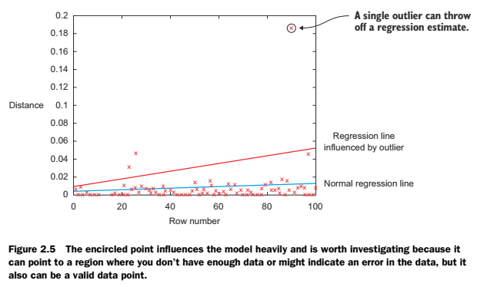
Step 3: Data Preparation: Data cleansing
  Sometimes you’ll use more advanced methods, such as simple modeling, to find and identify data errors; diagnostic plots can be especially insightful.

Slide 12
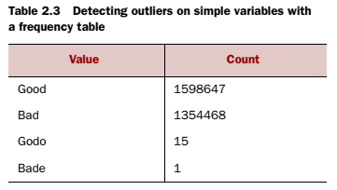

Step 3: Data Preparation: Data cleansing
DATA ENTRY ERRORS:
Data collection and data entry are error-prone processes.
They often require human intervention, and because humans are only human, they make typos or lose their concentration for a second and introduce an error into the chain.
But data collected by machines or computers isn’t free from errors either.
Errors can arise from human negligence/incompetence, whereas others are due to machine or hardware failure.
Examples of errors originating from machines are transmission errors or bugs in the extract, transform, and load phase (ETL).

Slide 13
Step 3: Data Preparation: Data cleansing
Redundant Whitespace
  Whitespaces tend to be hard to detect but cause errors like other redundant characters would. Like in table key values used can be
  Hard to diagnose/ find such errors
  For instance, in Python, you can use the strip() function to remove leading and trailing spaces.
  Fixing Capital Letter Mismatches
    Capital letter mismatches are common.
    Most programming languages make a distinction between “Brazil” and “brazil”.
    In this case you can solve the problem by applying a function that returns both strings in lowercase, such as .lower() in Python.
    “Brazil”.lower() == “brazil”.lower() should result in true.

Slide 14
Step 3: Data Preparation: Data cleansing
Impossible Values And Sanity Checks
  Check the value against physically or theoretically impossible values.
    people taller than 3 meters or
    someone with an age of 299 years.
  Sanity checks can be directly expressed with rules:
    check = 0 <= age <= 120

Slide 15
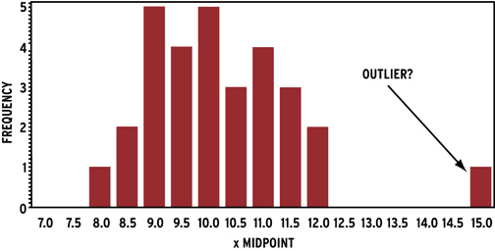
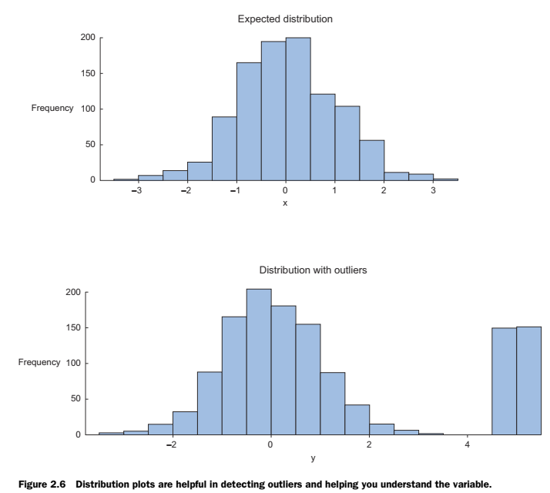
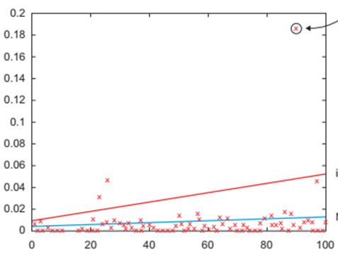
Step 3: Data Preparation: Data cleansing
OUTLIERS
  An observation that seems to be distant from other observations.
  The easiest way to find outliers is to use a plot or a table with the minimum and maximum values.
  figure 2.6: The plot on the left-side shows no outliers, whereas the plot on the right-side shows possible outliers.
  The normal distribution, or Gaussian distribution, is the most common distribution in natural sciences.
  The high values in the right-side graph can point to outliers when assuming a normal distribution.
  Need to investigate outliers first, because they can gravely influence your data modeling. Like regression.

Slide 16
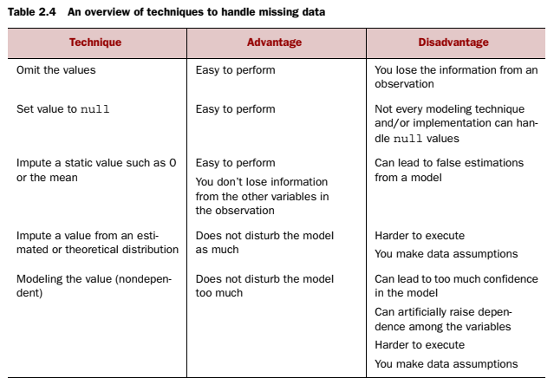
Step 3: Data Preparation: Data cleansing
DEALING WITH MISSING VALUES
Missing values aren’t necessarily wrong, but you still need to handle them separately; certain modeling techniques can’t handle missing values.
They might be an indicator that something went wrong in your data collection or that an error happened in the ETL (Extract, Transform, Load) process.
Common techniques data scientists use are listed in table 2.4.

Slide 17

Step 3: Data Preparation: Data cleansing
Different Units Of Measurement
When integrating two data sets, you have to pay attention to their respective units of measurement.
An example of this would be when you study the prices of gasoline in the world.
To do this you gather data from different data providers.
Data sets can contain prices per gallon and others can contain prices per liter.
A simple conversion will do the trick in this case.

Slide 18
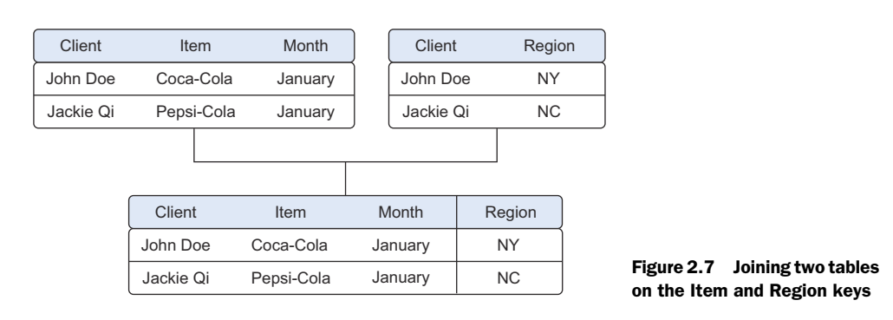
Combining data from different data sources
Your data comes from several different places, and in this substep we focus on integrating these different sources.
Data varies in size, type, and structure, ranging from databases and Excel files to text documents.
You can perform two operations to combine information from different data sets.
The first operation is joining:
  enriching an observation from one table with information from another table.
The second operation is appending or stacking:
  adding the observations of one table to those of another table.
When you combine data, you have the option to create a new physical table or a virtual table by creating a view.
The advantage of a view is that it doesn’t consume more disk space.

Slide 19
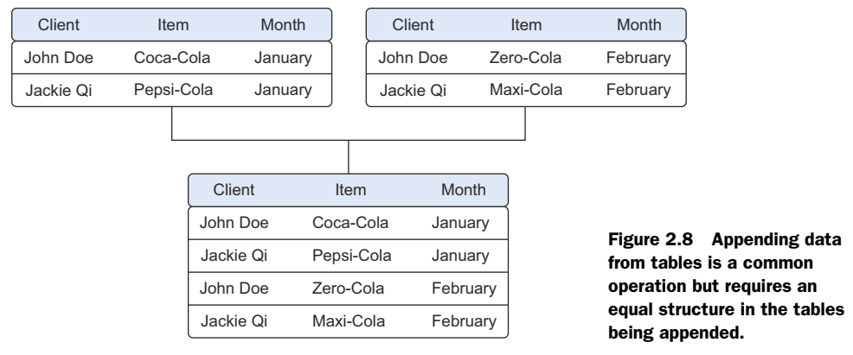
Combining data from different data sources
Joining tables allows you to combine the information of one observation found in one table with the information that you find in another table. The focus is on enriching a single observation, fig 2.7.
Appending or stacking tables is effectively adding observations from one table to another table. Figure 2.8 shows an example of appending tables.

Slide 20
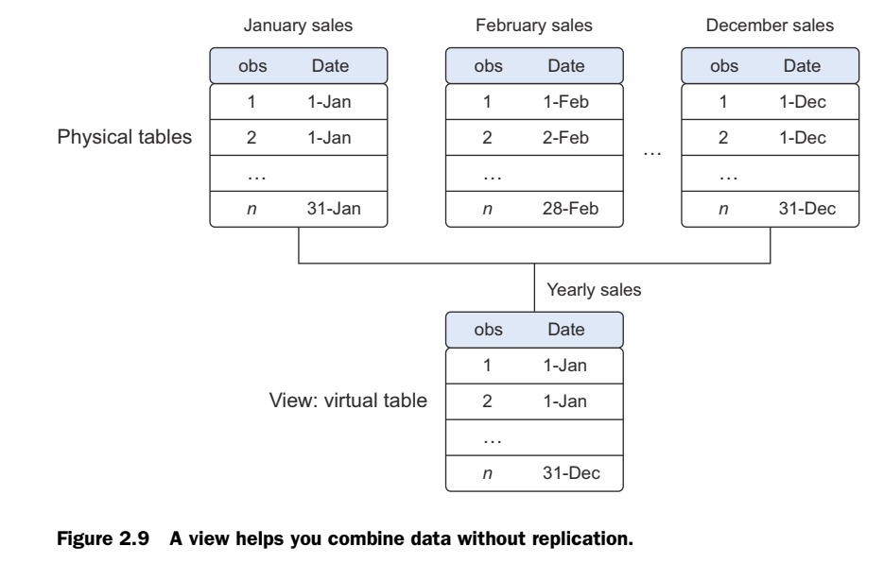
Combining data from different data sources
Using Views To Simulate Data Joins And Appends
  To avoid duplication of data, you virtually combine data with views.
  In the previous example we took the monthly data and combined it in a new physical table.
  The problem is that we duplicated the data and therefore needed more storage space.

Slide 21
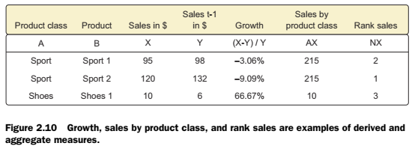
Combining data from different data sources
  Enriching aggregated measures
    Data enrichment can also be done by adding calculated information to the table, e.g.,
      the total number of sales or
      what percentage of total stock has been sold in a certain region

Slide 22
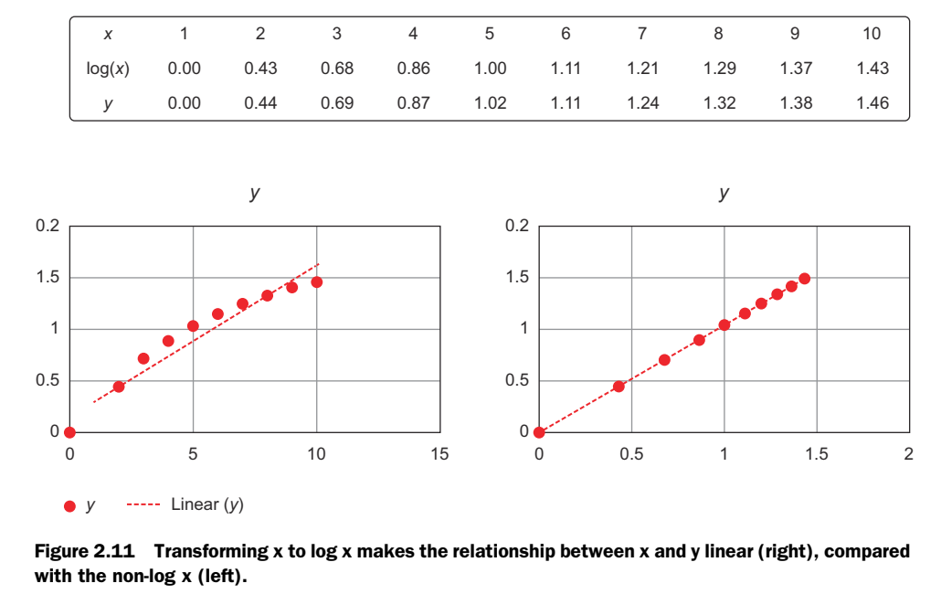
Transforming data
Certain models require their data to be in a certain shape.
Now that you’ve cleansed and integrated the data, this is the next task you’ll perform: transforming your data so it takes a suitable form for data modeling.
Transforming Data
  Relationships between an input variable and an output variable aren’t always linear.
  Take, for instance, a relationship of the form
    y = ae^{bx}.
  Taking the log of the independent variables simplifies the estimation problem dramatically.
  Figure 2.11 shows how transforming the input variables greatly simplifies the estimation problem.
  Other times you might want to combine two variables into a new variable.

Slide 23
Transforming data
Reducing The Number Of Variables
Sometimes you have too many variables and need to reduce the number because they don’t add new information to the model.
Having too many variables in your model makes the model difficult to handle, and certain techniques don’t perform well when you overload them with too many input variables.
For instance, all the techniques based on a Euclidean distance perform well only up to 10 variables.
For three dimensions we get Euclidean distance
Data scientists use special methods (Like principal component analysis (PCA)) to reduce the number of variables but retain the maximum amount of data.

Slide 24
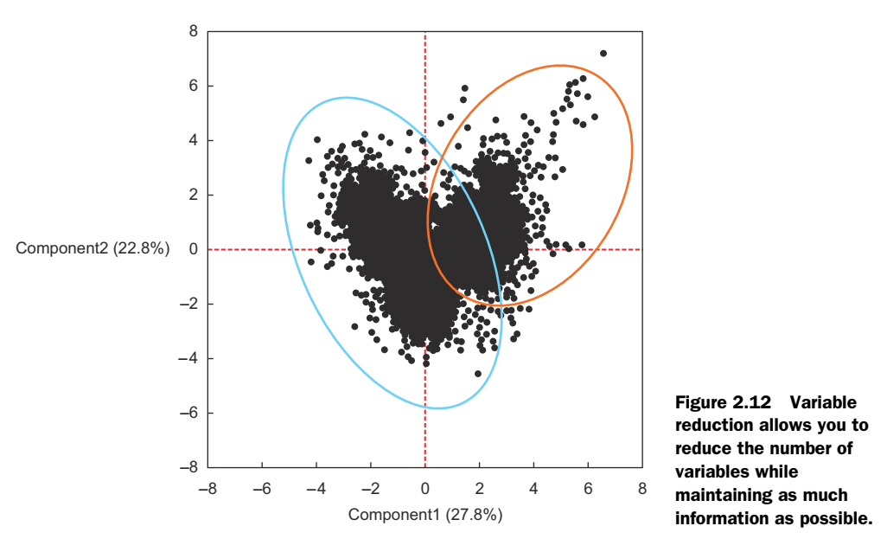
Transforming data

Slide 25
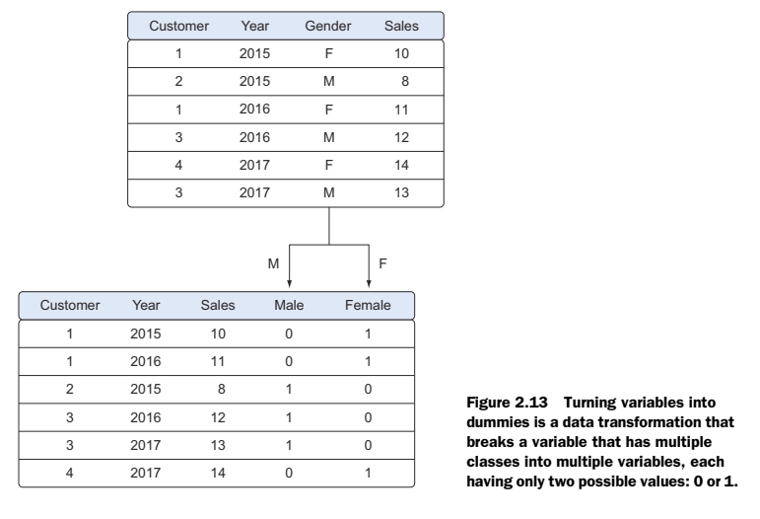
Turning Variables into Dummies
Variables can be turned into dummy variables (figure 2.13).
Dummy variables can only take two values: true(1) or false(0).
They’re used to indicate the absence of a categorical effect that may explain the observation. In this case you’ll make separate columns for the classes stored in one variable and indicate it with 1 if the class is present and 0 otherwise.
An example is turning one column named Weekdays into the columns Monday through Sunday. You use an indicator to show if the observation was on a Monday; you put 1 on Monday and 0 elsewhere.
Turning variables into dummies is a technique that’s used in modeling and is popular with, but not exclusive to, economists.

Slide 26
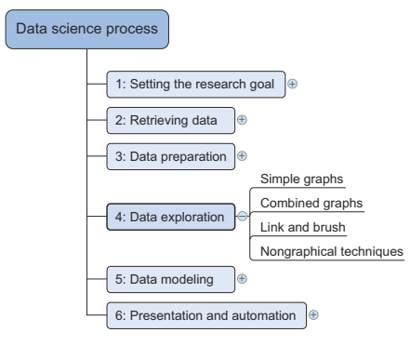
Step4: Exploratory data analysis
During exploratory data analysis you take a deep dive into the data (see figure 2.14).
Information becomes much easier to grasp when shown in a picture, therefore you mainly use graphical techniques to gain an understanding of your data and the interactions between variables.
The goal isn’t to cleanse the data, but it’s common that you’ll still discover anomalies you missed before, forcing you to take a step back and fix them.

Slide 27
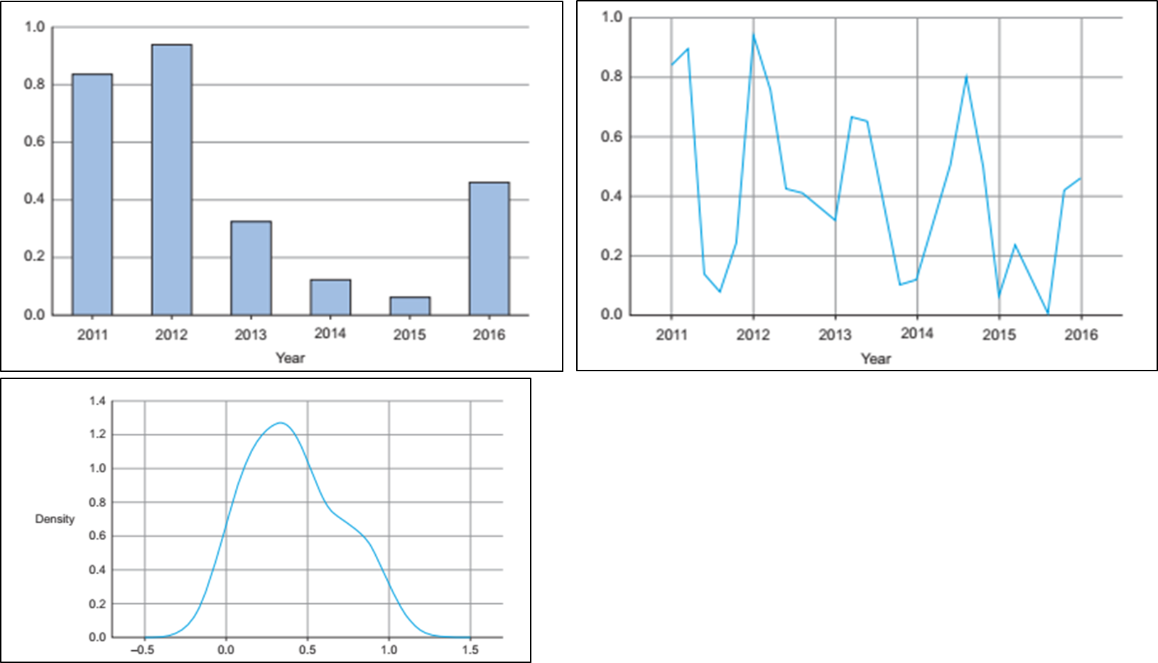
Step4: Exploratory data analysis

Slide 28
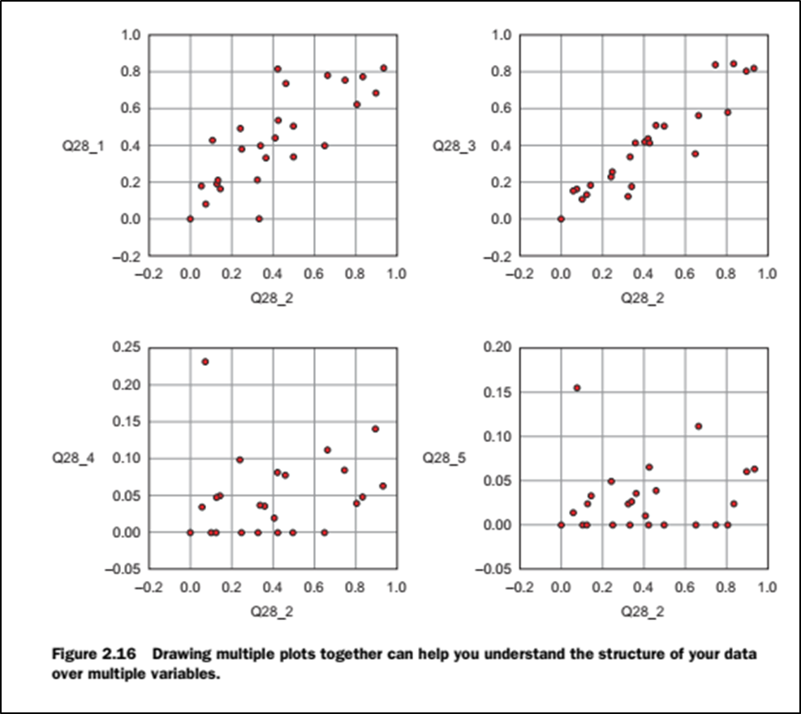
Step4: Exploratory data analysis

Slide 29
Step5: Building a model
Building a model is an iterative process.
The way you build your model depends on whether you go with classic statistics or the somewhat more recent machine learning school, and the type of technique you want to use.
Most models consist of the following main steps:
Selection of a modeling technique and variables to enter in the model
Execution of the model
Diagnosis and model comparison

Slide 30
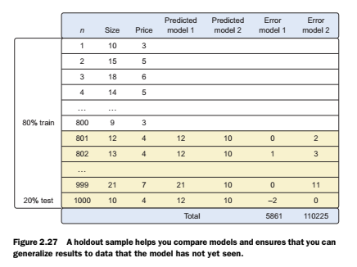
Model diagnostics and model comparison
To estimate the models, we use 800 randomly chosen observations out of 1,000 (or 80%), without showing the other 20% of data to the model.
Once the model is trained, we predict the values for the other 20% of the variables based on those for which we already know the true value, and calculate the model error with an error measure.
Then we choose the model with the lowest error. In this example we chose model 1 because it has the lowest total error.

Slide 31
Step 6: Presenting findings and building applications on top of them
After you’ve successfully analyzed the data and built a well-performing model, you’re ready to present your findings to the world

Slide 32
Summary
In this lecture we covered following topics:
  Setting research goal
  Gathering data
  Data Preparation
  Data Exploration
  Data Modeling
  Data Presentation

